Slide 1
ASL PREDICTIONS
Problem Statement
This project will seek to build a computer vision model to classify 24 of the 26 letters of the American Sign Language Alphabet utilizing the YOLOv5, a single stage object detector.
The letters j and z were excluded from this project as they require movement.

Slide 2
Our team
MATTHEW
TIMOTHY
CARLOS
LAVANYA

Slide 3
Table of contents
01
02
03
04
05
06
Group Goals
Approach
Our DATA & Labeling
Image Augmentation
YOLO v5 Model
PREDICTIONS

Slide 4
OVERVIEW & Group Goals
Why Image Recognition?
Work with raw image data
Leverage computer vision techniques
Google Colab exposure
Why American Sign Language (ASL)?
~500,000 individuals whose primary language is sign language
These individuals are being left behind as other Natural Language Processing technologies advance.

Slide 5

What is yolo?
“You Only Look Once”
Single-Stage Object Detector
Model Backbone
Cross-stage Partial Networks
Model Neck
PANet
Model Head
Final Output
Model Summary
Layers: 191
Parameters: 7,468,160
Gradients: 7,468,160
Activation Function: LeakyRelu, Sigmoid
Optimizer: SGD
Notes:
Model Backbone is how the model extracts important features. CPN is important as it lowers the computational requirements drastically.
Model Neck is how the model generates feature pyramids which allow the model to classify the same object presented in different sizes and scales. This improves performance on unseen data.
Model Head is the last step, generating final output vectors which include class probabilities, objectness scores, and bounding boxes.

Slide 6





RESOURCES And Shout-Outs
Yolov5 GitHub: https://github.com/ultralytics/yolov5
PyTorch: https://pytorch.org/
Wandb.ai: https://wandb.ai/
Labeling Software labeling: https://cvat.org/
Keras Preprocessing: https://keras.io/api/preprocessing/
Roboflow: https://app.roboflow.com/

Slide 7
Approach
Creating OUr Dataset
Labeling
Augmentation
Yolov5
Assigning each image a bounding box and classification
Leveraged Roboflow augmentation to get additional images
Training and Testing on our custom data
Created ASL images

Slide 8
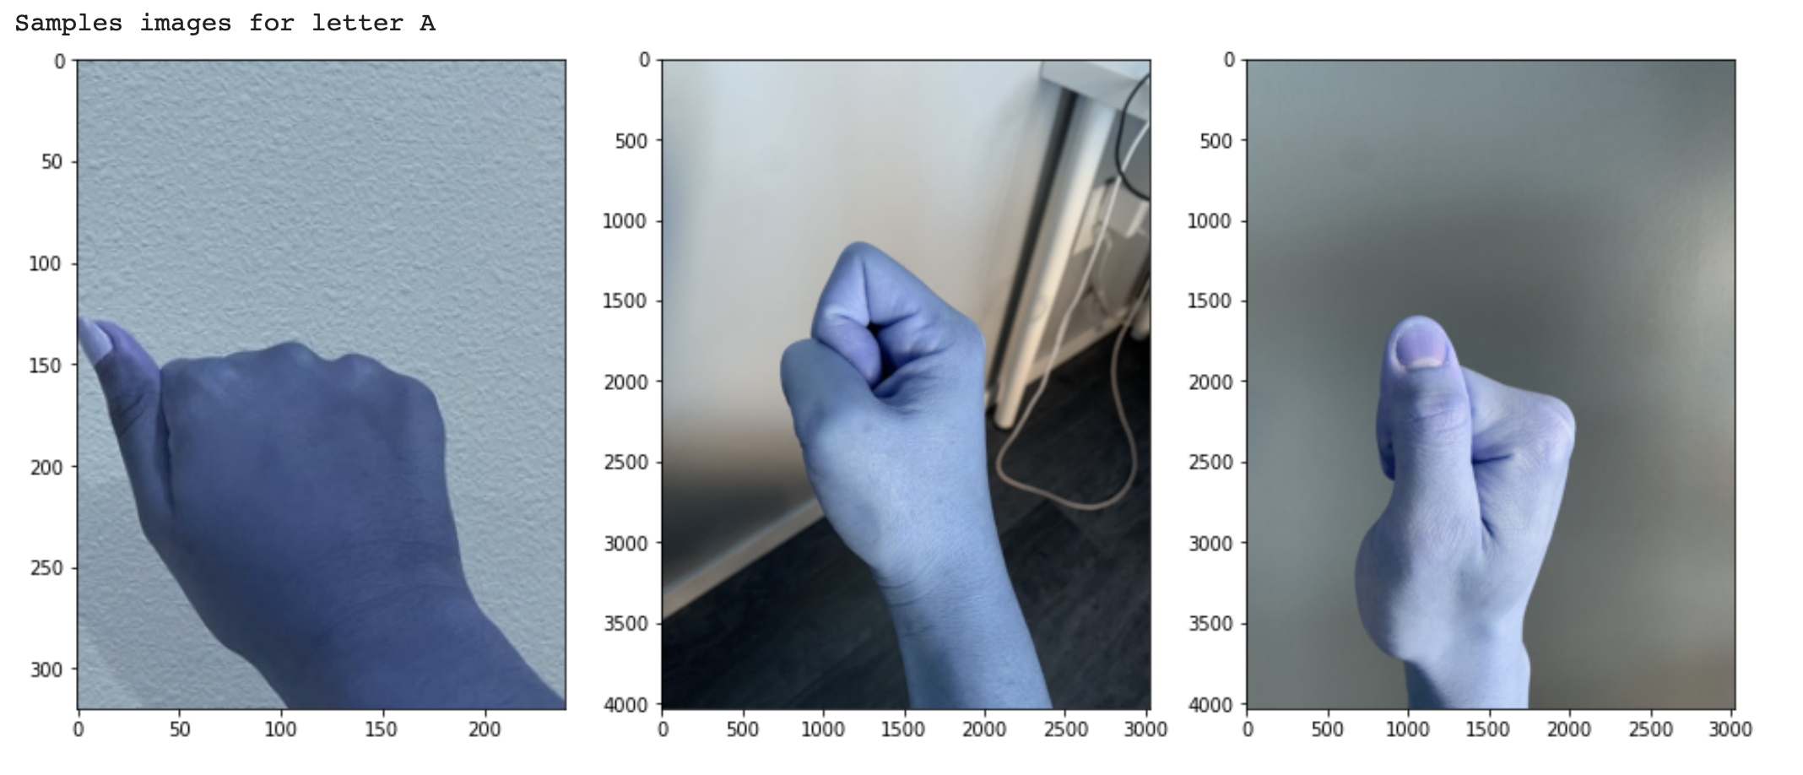
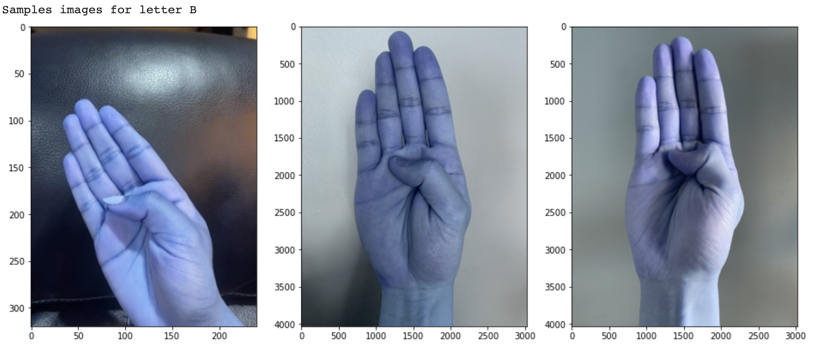
Check out few LABELS
Notes:
Carlos and Lavanya talk about their experiences with CVAT

Slide 9
YOLO v5 Model
!python train.py --img 640 --batch 50 --epochs 200 --data asl.yaml --weights yolov5s.pt
What does this piece of command line code do?
--img 640: Tells YOLOv5 what size the images are
--batch 50: Sets the batch size for processing
--epochs: Sets the length of time for training
--data asl.yaml: Where the train/test directories are, as well as a list of labels
--weights yolov5s.pt: Pretrained weights provided by YOLOv5 Github
Notes:
Talk about recommended epochs being 3000
Struggles with asl.yaml and what exactly that is
Weights, specifically the yolov5s weights

Slide 10
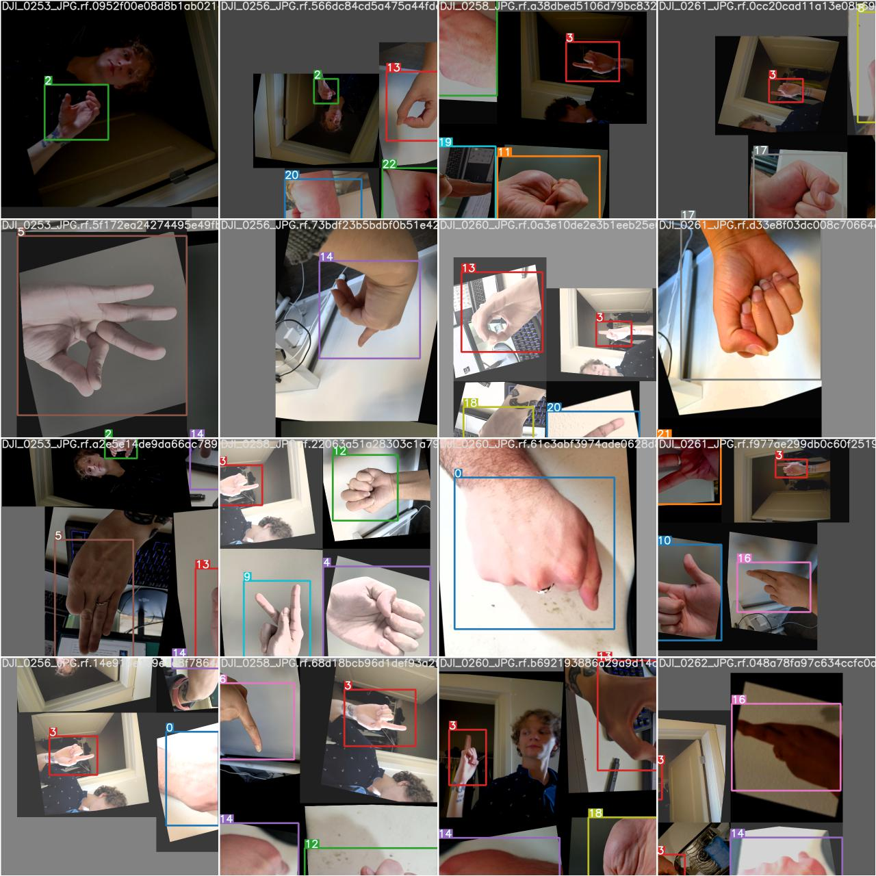
Training Images
Notes:
Briefly speak about the various reporting visualizations YOLOv5 automatically generates.

Slide 11
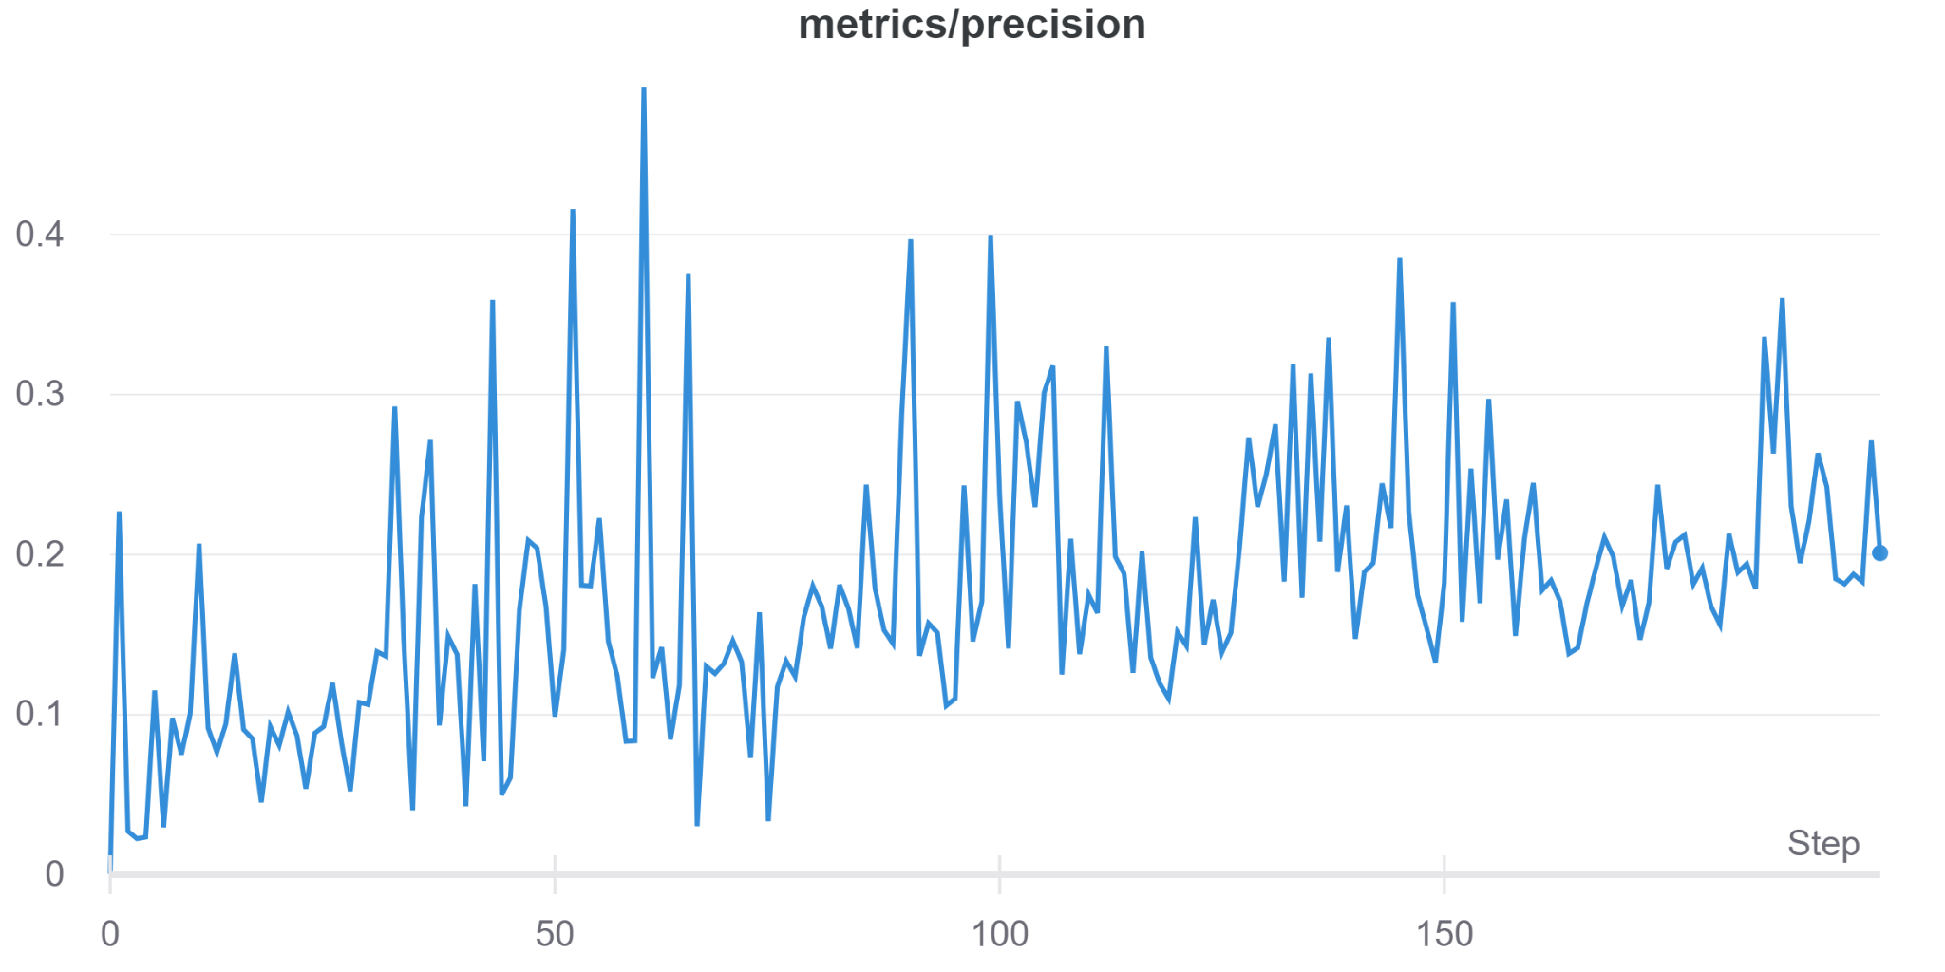
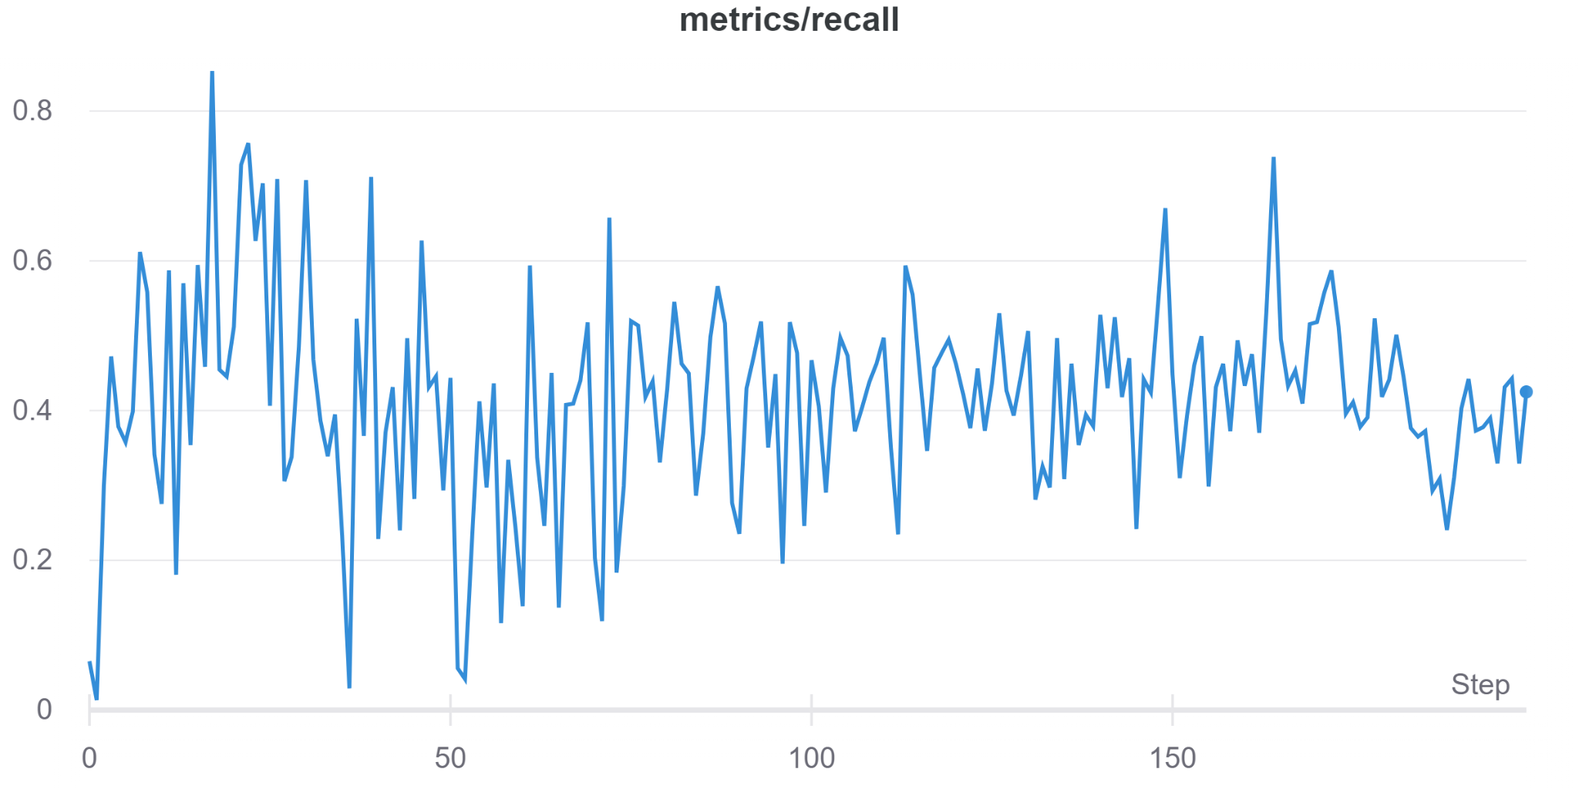
Yolo Metrics
https://wandb.ai/mdmhemsley/YOLOv5/runs/
Notes:
Screenshare Wandb.ai visualizations
The YOLO family of models has a metric to monitor loss based on objectness score, class probability score, and bounding box regression score.

Slide 12
Model Predictions
!python detect.py --weights /content/yolov5/runs/train/<most recent exp directory>/weights/best.pt --img 640 --conf 0.25 --source test/images/
What does this piece of command line code do?
--weights: Filepath to the weights that our model just generated during training.
--img: Size of the image
--conf: Confidence Interval for our model’s labelling
--source: Filepath containing our test images

Slide 13
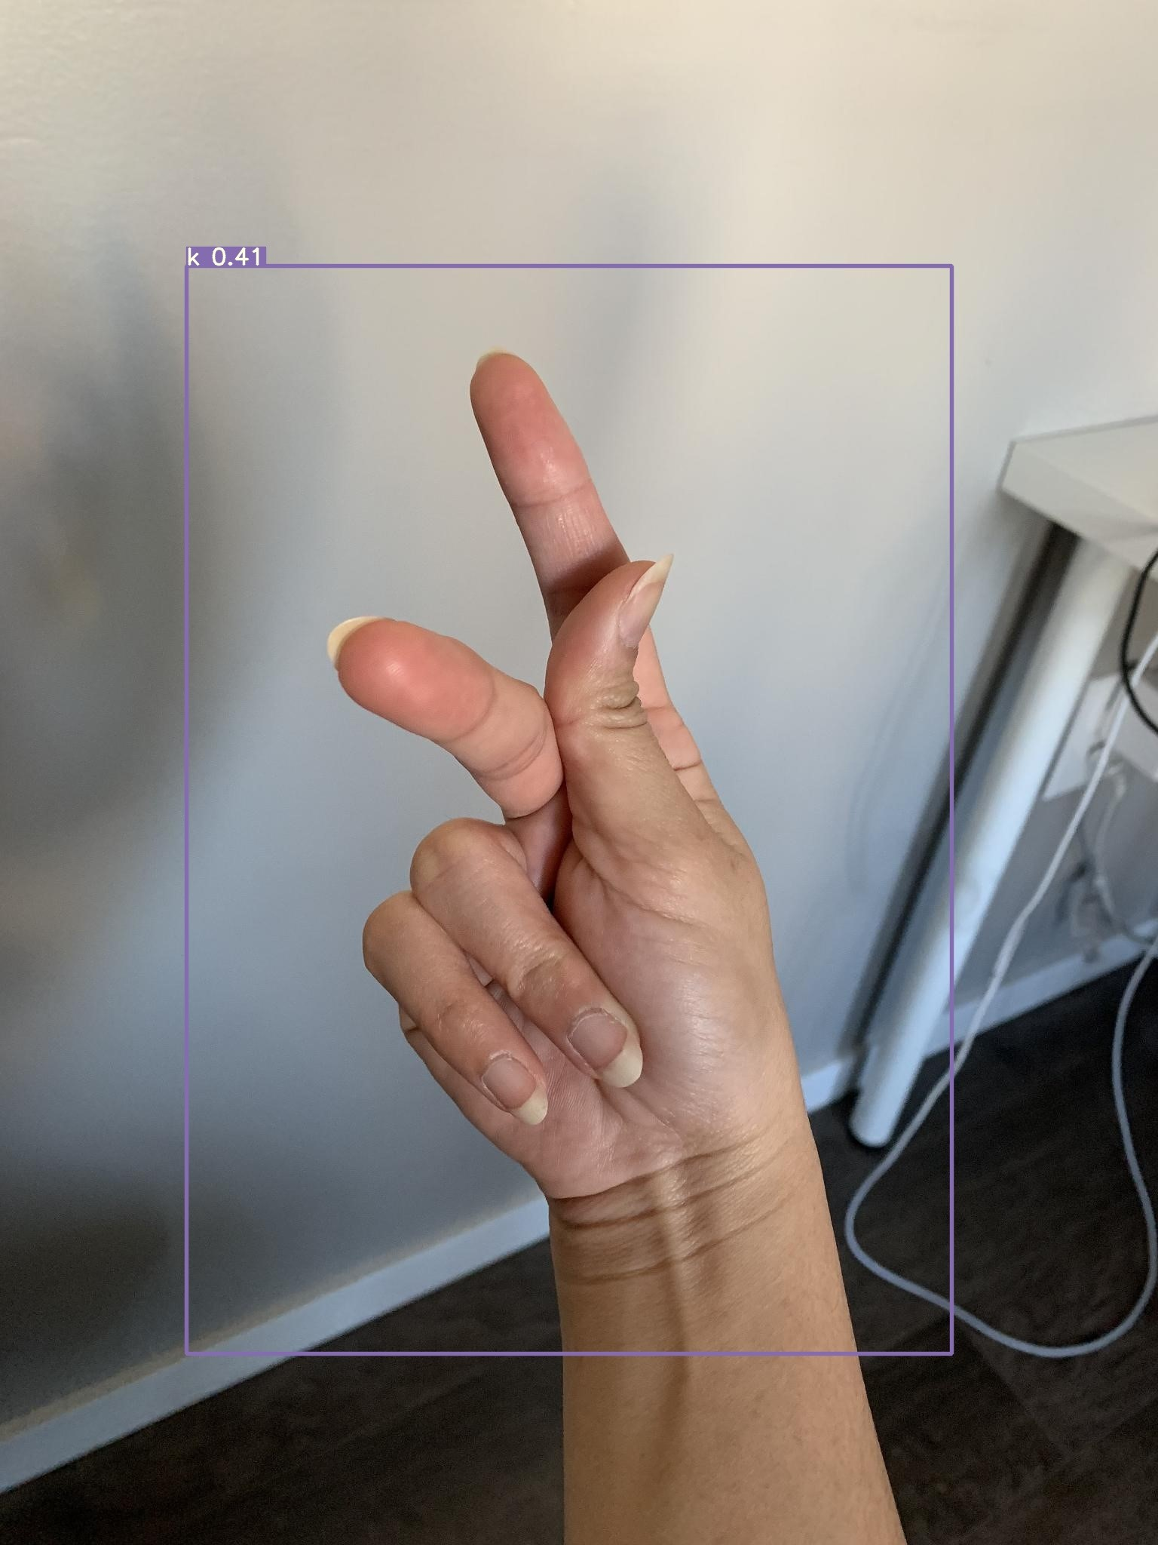
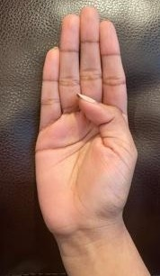
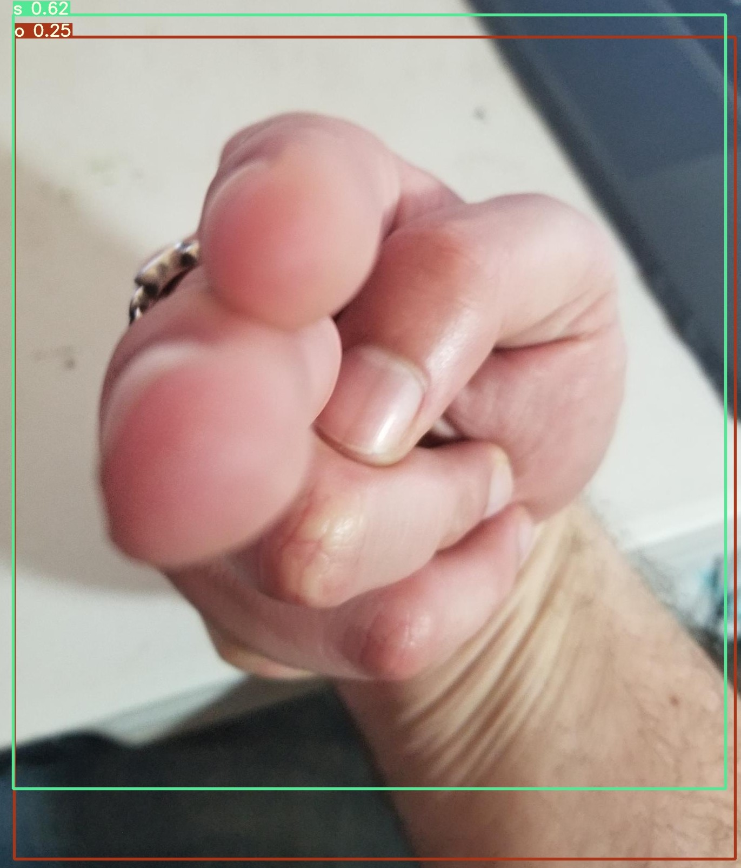
Model Predictions
Notes:
Two Important Types of Errors
No Label Whatsoever - Model not confident enough to make a prediction
Duel Label - Model believe image contains multiple classes, when it does not

Slide 14
Conclusions and Future Thoughts
Yolov5
Webcam
MORE EPOCHS!!!
Powerful, but resource intensive
Live video recognition
We were only able to utilize a fraction of YOLOv5
Image Data
Improvements
Future Opportunities
Completely different data beast
Cleaner training data
Different Models
Active Learning
Returning ASL Images

Slide 15
Thanks!
Do you have any questions?
Please keep this slide for attribution

